Slide 1
Estimator Design
Open-loop estimator
Closed-loop estimator
Comparison between state feedback and estimator design
Observability
Observer canonical form
Relationship between control & observer canonical forms

Slide 2













Estimator Design
In most systems, not all the states are measured. Some
states have to be estimated for state feedback control.
One possibility:
Assume
J = 0:
Σ

Slide 3
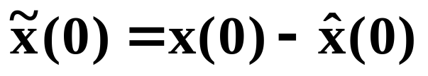
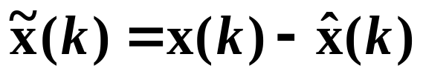


Open-loop Estimator Problems
Do not know what x(0) is exactly.
Usually some modeling errors exist.
The initial error may grow over time or go to zero too slowly to be useful.
Estimator error dynamics:
Estimate error has same dynamics as uncompensated system!

Slide 4
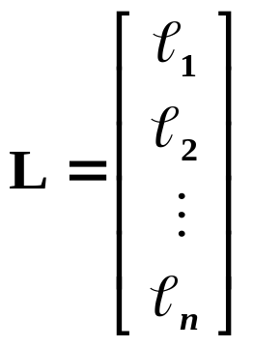


Using Feedback
Can we alter the behavior or performance of the estimator through feedback?
where
Estimator error dynamics:

Slide 5




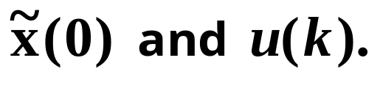
Characteristic equation
of estimate error:
Can choose L to change dynamics of the estimator.
If we can choose L such that has fast, stable eigenvalues, then the estimate error for all

Slide 6
Comparison Between State Feedback and Estimator Design
Plant is a physical process.
Controller design affects physical system directly.
  Choice of actuators/motors.
Estimator is a software algorithm.
  Making estimator have fast poles does not affect the choice of motors.
  If estimator poles are too fast, the measurement noise of sensors may become noticeable in the estimates.

Slide 7
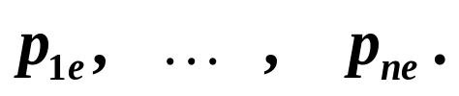
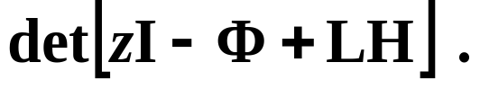

Designing L is similar to designing K
Determine desired estimator poles
Form desired estimator characteristic polynomial:
Match coefficients with
Is it always possible to solve for L for any desired

Slide 8
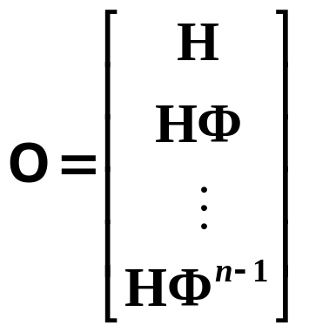

Observability
It is possible to arbitrarily assign estimator poles if and only if the system is observable.
If the system is not observable, it may be possible to solve for L to move some of the estimator poles, but can not move all the poles.
Definition: A system is observable if and only if the observability matrix is nonsingular, where the observability matrix is:
system is observable

Slide 9
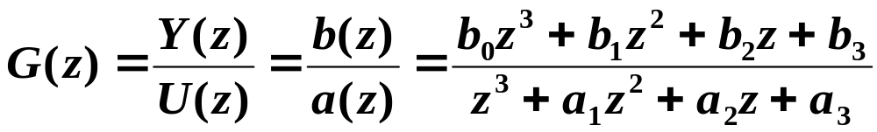
Observer Canonical Form
Consider third-order system for simplicity:

Slide 10
Block Diagram of Observer Canonical Form

Slide 11



Slide 12
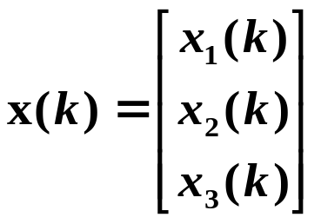


We have:
In state-variable matrix notation:
where

Slide 13
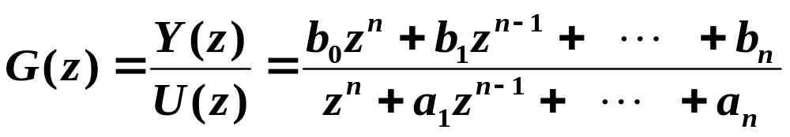
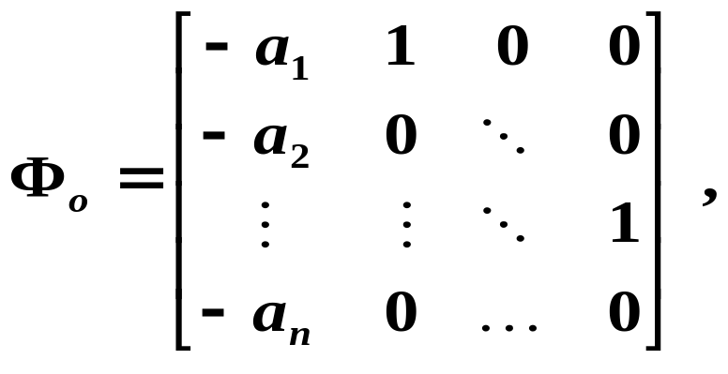
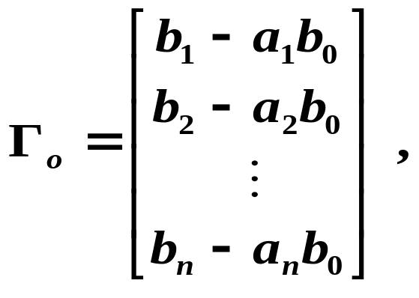
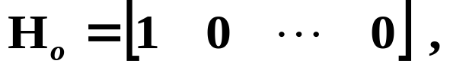

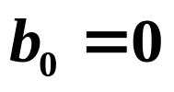
Observer Canonical Form in General
Given
If strictly proper:

Slide 14
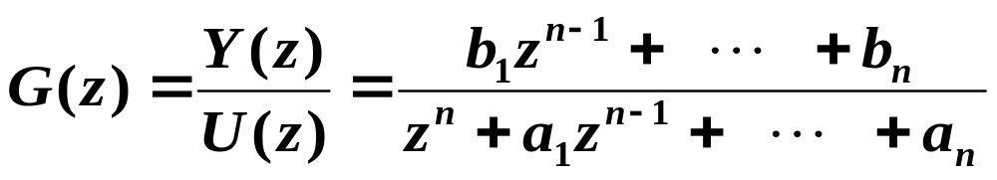
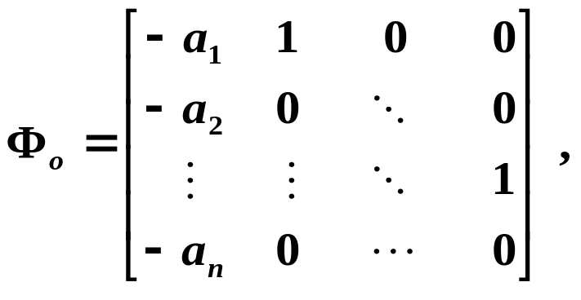
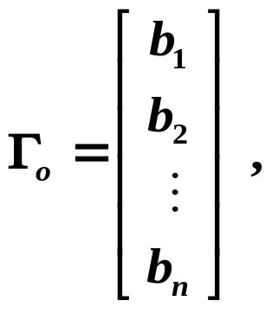
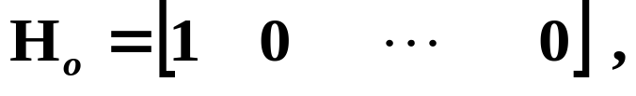

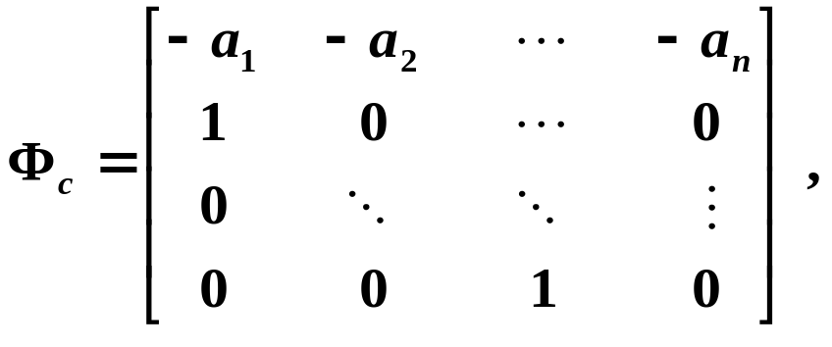
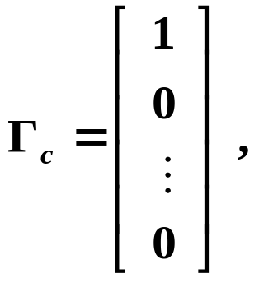


Relationship Between Control & Observer Canonical Forms
Given
Observer canonical form:
Control canonical form:

